Slide 1
10. Creating Data Types
1.1–1.2
Notes:
(10.1a) Identify appropriate behaviors and attributes of real-world entities to create a class.
(10.1b) Write program code to define a new data type by creating a class.
(10.1c) Design and implement a simple class from given specifications.
(10.1d) Explain the purpose of a constructor.
(10.1e) Explain the purpose of overloading constructors.
(10.1f) Distinguish among parameter variables, local variables, and instance variables.
(10.1g) Differentiate between publicand privateaccess modifiers.
(10.1h) Explain the purpose of declaring variables with the finalmodifier in a class.
(10.1i) Explain the difference between instancemethods andclass
(10.1j) Write instance methods that have new data type objects as parameters.
(10.1k) Write instance methods that have new data type objects as return types.
(10.1l) Write instant methods that have new data type objects as local variables.
(10.1m) Write a client program that will create and use objects of a class that you wrote.
(10.1n) Write client programs that test all methods of your newly created data type.
(10.1o) Document all instant methods by including pre- and post- conditions in your code.

Slide 2
10. Creating Data Types
Overview
OOP
Adopted and modified from Slides by Sedgewick and Wayne

Slide 3

Basic building blocks for programming
any program you might want to write
objects
functions and modules
graphics, sound, and image I/O
arrays
Ability to bring life
to your own
abstractions
conditionals and loops
Math
text I/O
primitive data types
assignment statements

Slide 4

Object-oriented programming (OOP)
Object-oriented programming (OOP).
Create your own data types.
Use them in your programs (manipulate objects).
An object holds a data type value.
Variable names refer to objects.
Example:
data type | set of values | examples of operations
String | sequence of characters | length, substring, compare
An abstract data type is a data type whose representation is hidden from the client.
Impact: We can use ADTs without knowing implementation details.
Previous lecture: how to write client programs for several useful ADTs
This lecture: how to implement your own ADTs

Slide 5
Implementing a data type
To create a data type, you need provide code that
Defines the set of values (instance variables).
Implements operations on those values (methods).
Creates and initialize new objects (constructors).
In Java, a data-type implementation is known as a class.
A Java class
Instance variables
Declarations associate variable names with types.
Set of type values is "set of values".
instance variables
constructors
Methods
Like static methods.
Can refer to instance variables.
methods
Constructors
Like a method with the same name as the type.
No return type declaration.
Invoked by new, returns object of the type.
test client

Slide 6
Anatomy of a Class
Write program code to define a new data type by creating a class.
Distinguish among parameter variables, local variables, and instance variables.
LO 10.1bf
text file named
Charge.java
public class Charge
{
private final double rx, ry; // position
private final double q; // charge value
public Charge(double x0, double y0, double q0)
{
rx = x0;
ry = y0;
q = q0;
}
public double potentialAt(double x, double y)
{
double k = 8.99e09;
double dx = x - rx;
double dy = y - ry;
return k * q / Math.sqrt(dx*dx + dy*dy);
}
public String toString()
{ return q + " at " + "(" + rx + ", " + ry + ")"; }
public static void main(String[] args)
{
Charge c = new Charge(.72, .31, 21.3);
StdOut.println(c);
StdOut.printf("%6.2e\n", c.potentialAt(.42, .71));
}
}
instance variables
constructor
methods
not “static”
static method
(familiar)
test client
% java Charge
21.3 at (0.72, 0.31)
3.61e+11
Notes:
(10.1f) Distinguish among parameter variables, local variables, and instance variables.
(10.1b) Write program code to define a new data type by creating a class.

Slide 7
Role of a Constructor
LO 10.1d
Explain the purpose of a constructor.
public class Charge
{
…
public Charge(double x0, double y0, double q0)
{
rx = x0;
ry = y0;
q = q0;
}
public double potentialAt(double x, double y)
{ … }
public String toString()
{ …}
constructor
methods
Constructors
Like a method with the same name as the type.
No return type declaration.
Invoked by new, returns object of the type.
Constructor body is executed when new object is created with new
Notes:
(10.1d) Explain the purpose of a constructor.

Slide 8
Overloaded Constructors
LO 10.1e
Explain the purpose of overloading constructors.
public class Charge
{
…
public Charge(double x0, double y0, double q0)
{
rx = x0;
ry = y0;
q = q0;
}
public Charge()
{
rx = 0;
ry = 0;
q = 0;
}
constructor
constructor
Constructors
A class can have more than one constructor.
All constructors of a class have the same name
Compiler can tell constructors apart because they take different parameters
Notes:
(10.1e) Explain the purpose of overloading constructors.

Slide 9
Example 1. Designing a simple class from given specifications
LO 10.1c
public class Student
{
private String lastName;
private String firstName;
private double gpa;
private int studentID;
public Student()
{
lastName = “Doe”;
firstName = “John”;
}
public Student(String lastName, String firstName)
{
this.lastName = lastName;
this.firstName = firstName;
}
Design and implement a simple class from given specifications..
Attributes of a student (as instance variables)
Default constructor
overloaded constructor
refer to method parameters
refer to instance variables
Designing a class
Identify class attributes.
Design class object constructors
Design behavior of objects (class methods)
Notes:
(10.1c) Design and implement a simple class from given specifications.

Slide 10
Example 2. Designing a simple class from given specifications
LO 10.1c
public class Point
{
private double x;
private double y;
public Point()
{
x = 0.0;
y = 0.0;
}
public Point(double x, double y)
{
this.x = x;
this.y = y;
}
public double getX( )
{
return x;
}
public double getY( )
{
return y;
}
// other methods
Design and implement a simple class from given specifications..
Attributes of a point
Designing a class
Accessor methods provide access to private attributes of a class
Accessor methods protects the private attributes from unauthorized changes
Accessor method
Accessor method
Notes:
(10.1c) Design and implement a simple class from given specifications.

Slide 11
Example 2. Designing a simple class from given specifications continued..
LO 10.1jk
public class Point
{
private double x;
private double y;
public Point()
{ … }
public Point(double x, double y)
{ ….}
public double getX( )
{ … }
public double getY( )
{ … }
// other methods
public double findSlope(Point other) {
return Math.sqrt((x - other.getX())* (y - other.getY()));
}
public Point findMidPoint (Point other){
double midX = (x + other.getX())/2;
double midY = (y + other.getY())/2;
return new Point(midX, midY);
}
Write instance methods that have new data type objects as parameters.
Write instance methods that have new data type objects as return types.
Objects as parameters and return types
Objects can be passed as parameters to a function.
Objects can be returned from functions.
object as a parameter
object as a return value
Notes:
(10.1j) Write instance methods that have new data type objects as parameters.
(10.1k) Write instance methods that have new data type objects as return types.

Slide 12
Pre and post conditions
Document all instant methods by including pre- and post- conditions in your code.
LO 10.1o
public class Point
{
….
// other methods
public double findSlope(Point other) {
//pre-condition. assert( other instanceof Point)
double slope = Math.sqrt((x - other.getX())* (y - other.getY()));
// post-condition. none
return slope;
}
public Point findMidPoint (Point other){
//pre-condition. assert( other instanceof Point)
double midX = (x + other.getX())/2;
double midY = (y + other.getY())/2;
Point midPoint = new Point(midX, midY);
//post condition . assert(midPoint instanceof Point)
return midPoint;
}
Pre and post conditions
Pre-condition. What is known about function state at the beginning
Post-condition. What is known about function state at end
assures the return of proper object
An assertion is a Boolean expression that you are affirming is true at some point during the execution of the program
Notes:
(10.1o) Document all instant methods by including pre- and post- conditions in your code.

Slide 13
Comparing objects
public class Point
{
….
public boolean equals(Object obj) {
if (obj instanceof Point) {
Point p = (Point) obj;
return (this.x = p.x && this.y == p.y);
}
else
return false;
}
test to assure obj is indeed a Point
Comparing objects
Define. What it means for objects of the same type to be equal.
Warning. Do not compare objects to objects (as they only compare the references)
E.g. If (point1 == point2) ….
Definition for Point equality
only compares references
Notes:
(10.1m) Write a client program that will create and use objects of a class that you wrote.
(10.1n) Write client programs that test all methods of your newly created data type.

Slide 14
PointTester.java
public class PointTester {
public static void main ( String[] args ) {
Point p1 = new Point(3,4);
Point p2 = new Point();
Point p3 = new Point (3,4);
System.out.println("p1 = " + p1);
System.out.println("p2 = " + p2);
System.out.println("p3 = " + p3);
Point midpoint = p1.findMidPoint ( p2 ) ;
System.out.println ( midpoint + " is midpoint of " + p1 + " and " + p2 );
System.out.println ( p1.findDistanceFromOrigin() + " is the
distance between the origin and " + p1 );
System.out.println ( p1.findDistanceBetween(p2) + " is the distance
between " + p1 + " and " + p2 );
System.out.println(p2.findSlope (p1) + " is the slope
between " + p2 + " and " + p1);
System.out.println ( p1.equals ( p3) );
System.out.println ( p1 == p3 );
}
}

Slide 15
Displaying objects
public class Point
{
….
// overrides Object toString
public String toString() {
return ( "("+ this.x + ", " + this.y + ")" );
}
System.out.println(p) will print
(3.0, 4.0)
Without this, System.out.println(p) will print
Point@38cccef
getClass().getName() + '@' + Integer.toHexString(hashCode())
returns a string consisting of the name of the class of which the object is an instance, the at-sign character `@', and the unsigned hexadecimal representation of the hash code of the object.
Notes:
(10.1m) Write a client program that will create and use objects of a class that you wrote.
(10.1n) Write client programs that test all methods of your newly created data type.

Slide 16
Example 3. Designing a simple class from given specifications (FRACTION)
LO 10.1c
public class Fraction
{
private int numerator;
private int denominator
public Fraction(int n, int d)
{
this.numerator = n;
this.denominator = d;
}
public int getNumerator ( )
{
return this.numerator;
}
public int getDenominator( )
{
return this.denominator;
}
// What other methods?
Attributes of a fraction
Designing a class
Accessor methods provide access to private attributes of a class
Accessor methods protects the private attributes from unauthorized changes
Accessor method
Accessor method
Notes:
(10.1c) Design and implement a simple class from given specifications.

Slide 17

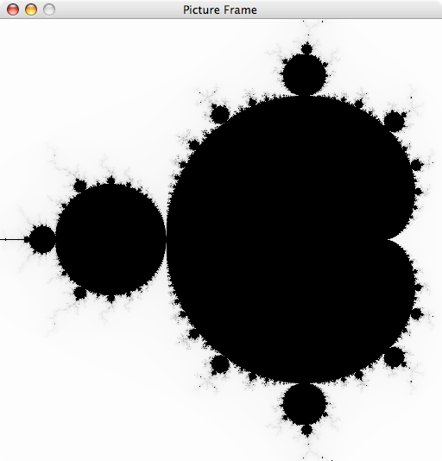
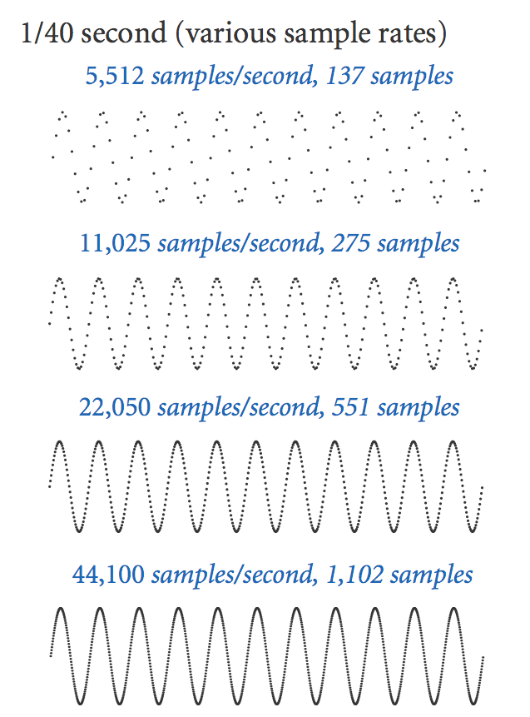
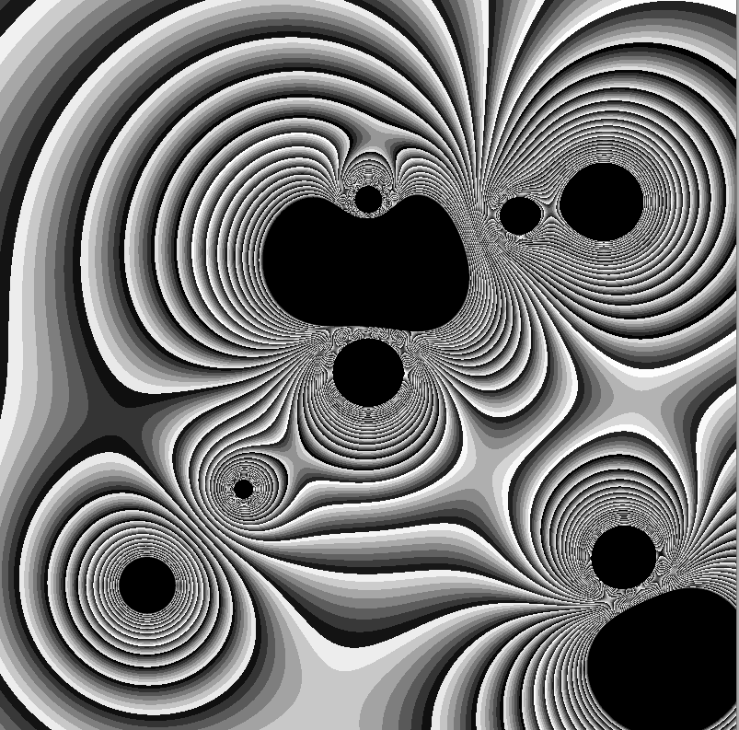


OOP summary
Object-oriented programming (OOP)
Create your own data types (sets of values and ops on them).
Use them in your programs (manipulate objects).
OOP helps us simulate the physical world
Java objects model real-world objects.
Not always easy to make model reflect reality.
Examples: charged particle, color, sound, genome….
OOP helps us extend the Java language
Java doesn't have a data type for every possible application.
Data types enable us to add our own abstractions.
Examples: complex, vector, polynomial, matrix, picture....
T | A | G | A | T | G | T | G | C | T | A | G | C

Slide 18
You have come a long way
any program you might want to write
objects
public class HelloWorld
{
public static void main(String[] args)
{
System.out.println("Hello, World");
}
}
functions and modules
graphics, sound, and image I/O
arrays
conditionals and loops
Math
text I/O
primitive data types
assignment statements
✓
Course goal. Open a whole new world of opportunity for you (programming).

Slide 19
Image sources
http://en.wikipedia.org/wiki/Leonhard_Euler#/media/File:Leonhard_Euler.jpg
http://en.wikipedia.org/wiki/Augustin-Louis_Cauchy
http://upload.wikimedia.org/wikipedia/commons/e/e9/Benoit_Mandelbrot_mg_1804-d.jpg
http://upload.wikimedia.org/wikipedia/commons/f/fc/Mandel_zoom_08_satellite_antenna.jpg
http://upload.wikimedia.org/wikipedia/commons/1/18/Mandelpart2.jpg
http://upload.wikimedia.org/wikipedia/commons/f/fb/Mandel_zoom_13_satellite_seehorse_tail_with_julia_island.jpg
http://upload.wikimedia.org/wikipedia/commons/4/44/Mandelbrot_set_à_la_Pop_Art_-_Wacker_Art_Fractal_Generator.jpg
Image sources
http://web.media.mit.edu/~papert/
http://en.wikipedia.org/wiki/Logarithmic_spiral
http://en.wikipedia.org/wiki/Logarithmic_spiral#/media/File:Nautilus_Cutaway_with_Logarithmic_Spiral.png
http://en.wikipedia.org/wiki/File:Low_pressure_system_over_Iceland.jpg

Slide 20
10. Creating Data Types
Overview

Slide 21
10. Creating Data Types
Section 3.2
http://introcs.cs.princeton.edu

